Slide 1


Special Need Plan 2024
Model of Care Training

Slide 2

Training Objectives
Describe the Clever Care Health Plan, Inc Model of Care (MOC)
List the four components of the MOC
Understand how members qualify for the Special Needs Plan (SNP)
Explain the SNP care management processes
Describe the provider requirements in the Health Risk Assessment (HRA)
Describe the provider roles & responsibilities in the Interdisciplinary Care Team (ICT)
Identify the quality outcomes & measures

Slide 3

Model of Care (MOC)
Medicare Advantage (MA) Special Needs Plans (SNPs) are designed for specific groups of members with special health care needs. CMS has defined three types of SNPs that serve the following types of members:
  Chronic Condition SNP (C-SNP)
  Dual Eligible SNP (D-SNP)
  Institutional SNP (I-SNP)
The MOC is a vital quality improvement tool and integral component for ensuring that the unique needs of each enrollee are identified by the SNP and addressed through the plan’s care management practices.

Slide 4


Clever Care Special Needs Program
Clever Care’s MOC is designed to ensure the provision and coordination of specialized services meet the needs of the SNP eligible beneficiaries by integrating benefits and coordinating care for members enrolled in Clever Care’s Special Needs Plan.
Clever Care Health Plan, Inc (Clever Care) C-SNP Special Needs Plan:
  Includes:
    Cardiovascular Disease
      cardiac arrhythmias
      coronary artery disease
      peripheral vascular disease
      Chronic venous thromboembolic disorder
    Diabetes Mellitus

Slide 5

Clever Care SNP Program Mission & Goals
SNP Mission Statement
The Clever Care SNP Programs are designed to maximize the quality of care, access to care, and health outcomes for the SNP populations it serves especially the most vulnerable population we serve
Overall Model of Care goals include:
Improve member health outcomes
Improve access to essential services
Improve access to affordable care
Improve coordination of care
Improve transitions of care
Improve access to preventive health services
Facilitate appropriate utilization of services
Engage provider network in Clever Care support services

Slide 6

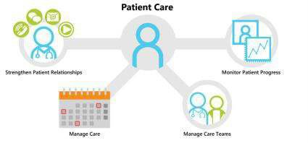


Model of Care Components
The SNP Model of Care is the overall plan for SNP structure, processes, resources, and requirements.
There are four (4) Model of Care Elements:
MOC 1 MOC 2 MOC 3 MOC 4
Target Population
Care Coordination
Provider Network
Quality Measurement

Slide 7
Model of Care Components
The SNP MOC includes the following:
MOC 1: Description of SNP Population
  A: Description of Overall SNP Population
  Subpopulation – Most Vulnerable Enrollees
MOC 2: Care Coordination
  A: SNP Staff Structure
  B: Health Risk Assessment Tool (HRAT)
  C: Face-to-Face Encounter
  D: Individualized Care Plan (ICP)
  E: Interdisciplinary Care Team (ICP)
  F: Care Transition Protocols
MOC 3: Provider Network
  A: Specialized Expertise
  B: Use of Clinical Practice Guidelines (CPGs) and Care Transition Protocols (CPTs)
  C: MOC Training for the Provider Network
MOC 4: MOC Quality Measurement and Performance Improvement
  A: MOC Quality Performance Improvement Plan
  B: Measurable Goals and Health Outcomes for the MOC
  C: Measuring Patient Experience of Care (SNP Member Satisfaction)
  D: Ongoing Performance Improvement Evaluation of the MOC
  E: Dissemination of SNP Quality Performance Related to the MOC

Slide 8
MOC 1
Description of SNP Population

Slide 9

Overall SNP Population
SNP MOCs must identify and describe the target population, including health and social factors, and unique characteristics of each SNP type.
Clever Care MOC:
Provides a foundation upon which the remaining measures build a complete continuum of care (e.g., end-of-life & special considerations) for current and potential members Clever Care intends to serve
Describes how Clever Care staff will determine, verify and track eligibility of SNP beneficiaries
Describes the social, cognitive and environmental factors, living conditions and co-morbidities associated with the SNP population
Identify and describe the medical and health conditions impacting SNP beneficiaries
Define the unique characteristics of the SNP population served

Slide 10

Most Vulnerable Beneficiaries
The focus is on population-level, not individual members:
What makes them “different from the general population”?
Include specially tailored services for members considered “most vulnerable” (e.g., multiple hospital admissions or excessive spending on medications above set limits)
Go above and beyond those service provided to the general population
Defines and identifies the most vulnerable beneficiaries within the SNP population and provides a complete description of specially tailored services for such beneficiaries
Explains how the average age, gender, ethnicity, language barriers, deficits in health literacy, poor socioeconomic status, as well as other factors, affect the health outcomes of the most vulnerable beneficiaries
Illustrates a correlation between the demographic characteristics of the most vulnerable beneficiaries and their unique clinical requirements
Identifies and describes established relationships with partners in the community to provide needed resources

Slide 11

Overall SNP Population & Most Vulnerable
C-SNP Chronically Ill
Diabetes & Cardiovascular Disease
  These populations have a high prevalence of physical and mental health conditions
  Members in these populations have complex needs and are more likely to see multiple providers, which can result in fragmented sub-optimal care coordination that can increase acute or emergency utilization.
Most Vulnerable Population
Members who are frail
Members who are disabled
Members who have multiple chronic illnesses
Members who have had multiple hospitalizations or skilled nursing facility admissions
Members who are at the end of their life
All our members are particularly vulnerable due to barriers they encounter related to ethnicity, health literacy, and socio-economic status.

Slide 12
MOC 2
Care Coordination

Slide 13
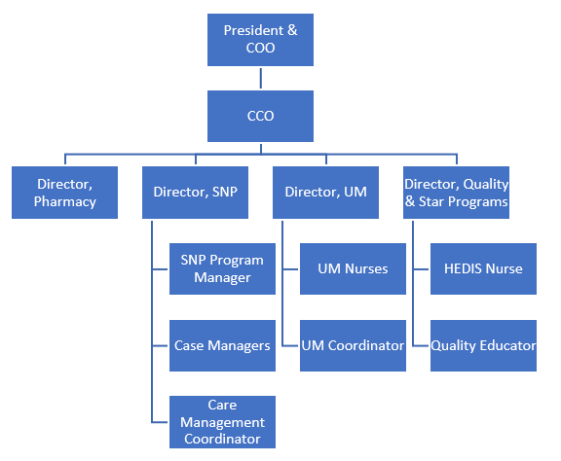
SNP Clinical Staff Structure
SNP MOCs must identify the staff structure and describe the administrative and clinical staff roles and responsibilities. Clever Care’s MOC:
Describe staff structure and functions
The administrative staff’s roles and responsibilities, including oversight functions
Describe the clinical staff’s roles and responsibilities, including oversight functions
Describe how staff responsibilities coordinate with the job title
Describe contingency plans used to address ongoing continuity of critical staff functions
Describe how the organization conducts initial and annual MOC training for its employed and contracted staff
Describe how the organization documents and maintains training records as evidence that employees and contracted staff completed MOC training
Describe actions the organization takes if staff do not complete the required MOC training

Slide 14
Health Risk Assessment Tool (HRAT)
All SNP members are offered HRAs and used to:
Identify individual health needs
Stratify members for service
Refer members for disease or case management programs
Initiate ICP development
Communicate with Interdisciplinary Care Team (ICT) members including providers, members, caregivers, and ancillary providers
HRAs can be completed via:
Mail
Telephonically
Electronically
HRAs are required to be completed within 90 days of enrollment and annually within 365 days of the prior HRA.
Members are educated on advanced Directive and Durable Power of Attorney, if necessary and additional information will be sent regarding these topics as requested.

Slide 15











Health Risk Assessment Tool (HRAT)
ICP and results of stratification are provided to PCP, member/caregiver/ICT
HRA
stratification results are incorporated into ICP
ICT reviews, analyzes, and stratifies member’s needs
CM uses HRA to determine member risk level
HRA scanned into system as electronic image, when applicable
HRA entered in system
CM reviews HRA
HRA
completed
RISK LEVELS:
① Hospitalization(s) regardless of primary diagnosis and increased symptoms compared to baseline
② Stable symptoms, at previous level of functioning, no hospitalizations in past 2 months (or 1 if enrolled in Health Coaching Program)
③ Stable symptoms, at previous level of functioning, no hospitalizations in past 3 months (or 2 if enrolled in Health Coaching Program)
④ Stable symptoms, at previous level of functioning, no hospitalizations in past 6 months (or 3 if enrolled in Clever Care Plus Complex Care Program)
⑤ No hospitalizations

Slide 16

Face-to-Face Encounter
Clever Care Case Management Program Includes face-to-face visits with the member to develop a professional and trusting relationship. During face-to-face visits, the case manager is able to assess the member and their home environment. The face-to-face visit also provides needed interaction with the member that may combat loneliness and have a positive impact on mental health. Items reviewed but not limited to include:
Written materials the member would like to review the case manager for a better understanding.
The case manager can conduct a home environment assessment to ensure hazards are addressed such as scatter rugs that increase the risk of a member fall.
Medication reconciliation to ensure the member is taking their medications as prescribed.
The case manager may identify changing needs of the member that were not expressed/identified telephonically.

Slide 17

Individualized Care Plan (ICP)
Code of Federal Regulations (42 CFR §422.101(f)(ii); 42 CFR§422.152(g)(2)(iv)) requires all SNPs to develop and implement an ICP for each individual enrolled in SNP
The case manager creates the ICP with input from the member and/or caregiver(s)
The ICP is based on the member’s HRA, encounter data, and any identified opportunities
The ICP is prioritized to consider the member’s preferences and their desired level of engagement
The ICP is updated to reflect any change in the member’s medical and psychosocial status
Revisions include evaluation of identified goals and progress towards goals
The ICP is communicated for coordination of care and when there is a transition to a new care setting, such as a hospital or Skilled Nursing Facility (SNF)
The ICP is also provided to PCP, member/caregiver, and applicable ICT members

Slide 18
Interdisciplinary Care Team (ICT)
Case Manager
Code of Federal Regulations (42 CFR §422.101(f)(iii); 42 CFR §422.152(g)(2)(iv)) require that all SNPs use an ICT in the care management of each individual enrolled in the SNP.
The ICT contributes to improving beneficiary health status and they meet regularly to manage the medical, cognitive, psychosocial and functional needs of the member.
The member and/or caregiver are always included as part of the ICT.
Others As Assigned By The Member
Primary Care Provider
Member
Specialty Provider
Behavioral Health Provider
Faith-Based Provider
Family/Caregiver

Slide 19

Transitions of Care (TOC)
Members can be faced with significant challenges when moving from one setting to another. The management of transitions is focused on supporting our Members with their treatment plan as they move from one setting to another to prevent re-admissions or delay of care needs.
Code of Federal Regulations (42 CFR §422.101(f)(2)(iii-v); 42 CFR §422.152(g)(2)(vii-x)) require all SNPs to coordinate the delivery of care. Code of Federal Regulations (42 CFR §422.101 (f)(2)(iii)-(v);42 CFR§422.152(g)(2)(ix)) require SNPs to demonstrate the use of clinical practice guidelines and care transition protocols.
Personnel Involved in Coordinating Care Transitions
Utilization review
Case manager
Transition case manager
Hospital social worker/discharge planner
Clever Care utilization review team utilizes care coordination processes to identify transition of care needs.
Clinical staff coordinate with providers and assist members to access care as appropriate.
SNP Case Managers ensure members have appropriate follow-up care post transition.

Slide 20

SNP MODEL OF CARE CORE CLINICAL PROCESS
Improving Care Coordination and Health Outcomes
Initial HRAs must be completed within 90 days of enrollment. Annual HRAs must be completed within 365 days of the prior HRA or attempt.
1. Health Risk Assessment (HRA)
The HRA & ICP are updated by the ICT with TOC and change in status.
5. Care Transition Protocols
(If applicable)
HRA results and other data is used to stratify and determine risk.
5. Transition of Care
(TOC) Protocols,
when applicable
2. Risk Stratification
Each SNP member will have an ICP to facilitate their coordination of care. ICPs are revised with changes in health status.
Every SNP member will have access to a care team (ICT) to support their ICP development and maintenance process.
4. Interdisciplinary Care Team (ICT)
3. Individualized Care Plan (ICP)
3. Individualized Care Plan (ICP)
The SNP MOC is continuous based on change in health status and applies to all SNP customers.

Slide 21
MOC 3
Provider Network

Slide 22

Specialized Network
Code of Federal Regulations (42 CFR§422.152(g)(2)(vi)) require SNPs to demonstrate that the provider network has specialized clinical expertise in delivery of care to beneficiaries.
The Clever Care provider network is comprised of specialized expertise corresponding to the target population.
  Clever Care oversees the provider network and facilities while ensuring its providers are competent and have active licenses
  How the SNP documents, updates and maintains accurate provider information
  How providers collaborate with the ICT and contribute to a beneficiary’s ICP to provide necessary specialized services

Slide 23
Use of Clinical Practice Guidelines (CPGs) and Care Transition Protocols (CTPs)
CPGs
  Monitor network providers to ensure they are using nationally recognized clinical practice guidelines when available
CTPs
  Monitor providers to ensure continuity of care when using the care transition protocols

Slide 24

MOC Training for the Provider Network
Clever Care conducts initial and annual training regarding the Clever Care C-SNP MOC for employed and contracted staff.
Training Standards & Requirements
Initial training to be completed within 30 days from hire and each calendar year thereafter.
Training may be provided in person or through self-study via the Clever Care Paycom website.
Attestation training completion is required.
Confirming name, title, and date of training
Training evaluation must be completed.
Oversight is monitored in various ways which include:
Face-to-face/via webinar - sign-in sheets and attestations
Computer based training - online program that tracks and records attempts/completion of MOC training by creating a report of training completed and not completed
Reports that show all electronic and paper attestations received to determine if additional training or outreach is needed to ensure compliance with training and attestation requirements

Slide 25
MOC 4
Quality Measure and Performance Improvement

Slide 26


Code of Federal Regulations (42 CFR §422.152(g)) require that all SNPs conduct a Quality Improvement Program (QIP) that measures the effectiveness of its MOC.
The Clever Care QIP monitors health outcomes and implementation of SNP MOCs: Collecting SNP specific HEDIS® measures.
  Meeting SNP Structure and Process standards.
  Conducting QIP reviews that focus on improving clinical services as they relate to our SNP population(i.e., Fall Prevention).
Providing a chronic care improvement program for chronic disease that identifies eligible members, intervenes to improve disease management, and evaluates program effectiveness.
Collecting data to evaluate if SNP and MOC goals are met.
  Using encounter data, HRAs, CAHPS, HOS and other methodologies as needed for data collection.
  Actions are taken when goals are not realized.
  QIC investigates to determine actions required.
    What was the root cause or factors that resulted in not meeting goals? Time frame, goal too broad or too specific?
Quality Improvement Program (QIP)

Slide 27




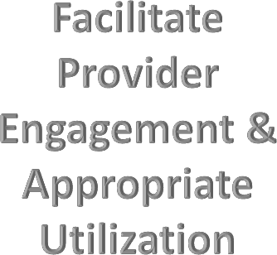









Measurable Goals and Health Outcomes for the MOC
The measurable goals focus on all aspects of care and health outcomes and are integrated into the performance improvement plan through ongoing monitoring and evaluation throughout the year.
The measurable goals are evaluated against benchmarks and thresholds as available.
The Quality Work Plan reviews the key indicators, measurable goals and benchmarks as needed.
Goals include:

Slide 28

Measuring Patient Experience and Care (SNP Member Satisfaction)
Evaluating member satisfaction is a top priority for Clever Care. This information is used to identify what is working well and any areas of opportunities. Member perception and experience assist with creating and updating programs, process, and workflows to allow for a better member experience. The following surveys will be utilized to measure member satisfaction.
  Case Management Satisfaction Survey
  Health Outcomes Survey (HOS)
  Medicare Advantage Prescription Drug Plan Consumer Assessment of Healthcare Providers and Systems (MA-PD CAHPS)

Slide 29

It is imperative that all directors, officers, employees and vendors comply with the standards contained in the Code of Conduct, immediately report any perceived violations and assist in investigating any allegations of wrong doing in keeping with Clever Care’s policy to prevent the occurrence of unethical or unlawful behavior, to halt such behavior as soon as reasonably possible after its discovery, and to discipline directors, officers, employees, or vendors who violate the standards contained in the Code. This includes anyone who fails to report a known violation.

Slide 30

Tools that Clever Care uses to gather quality performance indicators and measures to support ongoing improvement of the MOC include:
Ongoing Performance Improvement Evaluation of the MOC
Quality Work Plan
Annual Quality Assessment
Model of Care Review and Monitoring Summary Annual Report

Slide 31
Dissemination of SNP Quality Performance Related to the MOC
Quality program activities are communicated, including quality improvement performance results and MOC analysis to multiple stakeholders at least annually. Methods of communication are as follows:
Website postings
Formal, scheduled routine meetings
  Board of Director meetings
  Case Management Meetings
  Quality Workgroup meetings
  QMC meetings
  Management Team meetings
  Provider Learning Sessions
  Face-to-Face Clinic Visits
Member Stakeholder Committee meetings, with members, caregivers, and providers
Written communication
  Provider newsletter/communication
  Formal analysis reports sent annually to providers, QMC, Board of Directors, and external regulators
Ad hoc communication with stakeholders through other electronic means such as email, the web portal, and/or scheduled webinar or face-to-face trainings
The quality improvement performance results at also communicated least annually via the Annual Report, which is included in the member newsletter mailed to all members. Targeted mailings, and website postings are used to communicate other pertinent quality improvement information to members. Annually, members receive a summary of the Model of Care focusing on how the Model of Care can be used to improve their health outcomes.

Slide 32
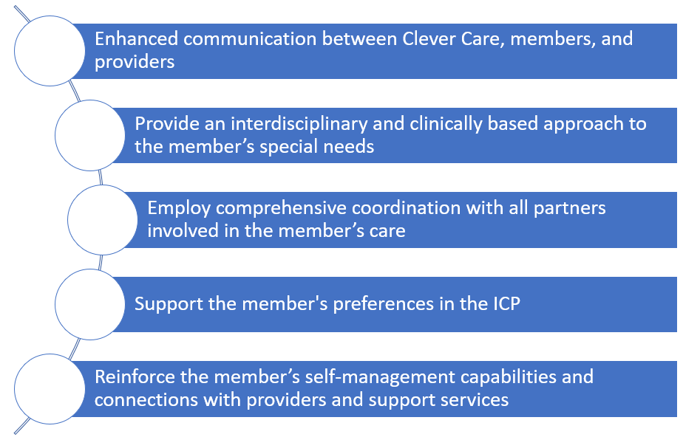
Summary
The Model of Care requires all of us to work together to benefit our members through:

Slide 33

Thank You
Thank you for participating in the Clever Care SNP MOC Training Program
To document completion of this training, please complete the required fields in attestation.

