Slide 1
Model of Care Provider Training
Clever Care Health Plan

Slide 2
Training Objectives
Understand the core components of MOC required by CMS.
Complete the training attestation.
Define the Model of Care (MOC) and explain its relevance in the context of healthcare delivery for special needs populations.

Slide 3
What is the purpose of MOC?
To effectively identify and address the unique needs of each member, the Model of Care (MOC) serves as the foundation for the Special Needs Plan’s (SNP) care management approach, supporting quality improvement, service access, care coordination, and overall care management processes.
The MOC must comply with all CMS requirements.
CMS grants MOC approval for a period of 1 to 3 years.
Annual MOC training is required by CMS for all relevant staff.
  References: Medicare Managed Care Manual, Chapter 5- Quality Assessment 20.2.1 - Model of Care Elements
  National Committee for Quality Assurance. (2024, October). Model of Care Scoring Guidelines for Contract Year 2026.

Slide 4
Purpose of MOC Training
Centers for Medicare & Medicaid Services (CMS) Requirement
  All Medicare Advantage Special Needs Plans (SNPs) must have a Model of Care (MOC) that describes the care and services to be provided to SNP members
  The MOC is a detailed document that provides the framework for how SNPs identify and address the unique needs of its SNP populations
  CMS carefully reviews the MOC during an audit to make sure we are implementing all processes as described, including MOC training
  References: Medicare Managed Care Manual, Chapter 5- Quality Assessment 20.2.1 - Model of Care Elements
  National Committee for Quality Assurance. (2024, October). Model of Care Scoring Guidelines for Contract Year 2026.

Slide 5
Purpose of MOC Training (cont’d)
The Centers for Medicare and Medicaid Services (CMS) requires providers who serve Medicare Advantage SNP members to complete annual training on the SNP MOC.
MOC training helps you:
  Understand the unique characteristics and needs of SNP members
  Understand the importance of your role as a member of the Interdisciplinary Care Team (ICT)
  Learn more about the role of the Care Coordinator (CC), including how you may interface with them and how they can help with the management of your SNP patients
  References: Medicare Managed Care Manual, Chapter 5- Quality Assessment 20.2.1 - Model of Care Elements
  National Committee for Quality Assurance. (2024, October). Model of Care Scoring Guidelines for Contract Year 2026.

Slide 6
CMS Required MOC Elements
The MOC is a key quality improvement tool used by SNPs to identify and address each enrollee’s unique needs through care management. It focuses on four core elements.
Element 1
Element 2
Element 3
Element 4
Description of SNP Population
Determining eligibility
Defines our most vulnerable members
Identifies relationships with community partners
Care Coordination
Staff structure & oversight process
HRA process
Annual face-to-face visit
Individualized care plan
Interdisciplinary care team
Transition of care management
Annual associate MOC training
Provider Network
  Adequate provider network with expertise to care for the SNP population
  Practice guidelines and care transition protocols
  Annual provider training
Quality Measurement & Performance Improvement
Defines the quality improvement plan
Includes how to identify, define and measure goals and health outcomes
  References: Medicare Managed Care Manual, Chapter 5- Quality Assessment 20.2.1 - Model of Care Elements
  National Committee for Quality Assurance. (2024, October). Model of Care Scoring Guidelines for Contract Year 2026.

Slide 7
MOC 1: Description of SNP Population
What is a Special Needs Plan?
Medicare Advantage (MA) Special Needs Plans (SNPs) are designed for specific groups of members with special health care needs. CMS has defined three types of SNPs that serve the following types of members:
Chronic Condition SNP (C-SNP) - Beneficiaries with certain chronic and disabling conditions
Dual Eligible SNP (D-SNP) - Beneficiaries who are eligible for both Medicare and Medicaid
Institutional SNP (I-SNP) - Beneficiaries who are institutionalized or require an institutional level of care (LOC)
Reference: Centers for Medicare & Medicaid Services; https://www.cms.gov/medicare/enrollment-renewal/special-needs-plans

Slide 8
MOC 2: Care Coordination Staff
Structure (Intro)
Fully define SNP staff roles and responsibilities for each care coordination function including:
Specific employed and/or contracted staff responsible for performing
  administrative functions
  clinical functions
  administrative and clinical oversight functions
Provide a copy of the SNP’s organizational chart showing how staff responsibilities are identified and coordinated with the job titles in the MOC
Identify the SNP contingency plan(s) used to ensure ongoing continuity of critical staff functions
Reference: 42 CFR § 422.101(f)(2)(ii)-(v); 42 CFR § 422.152(g)(2)(vii)-(x)

Slide 9
MOC 2: Care Coordination Staff Structure (cont’d)
The Care Coordination description must include:
How the SNP conducts initial and annual MOC training
How the SNP documents and maintain training records and evidence of MOC training
Challenges associated with completion of the MOC training
Specific actions the SNP will take when the required MOC training has not been completed or has been found to be deficient in some way.
Reference: 42 CFR § 422.101(f)(2)(ii)-(v); 42 CFR § 422.152(g)(2)(vii)-(x)

Slide 10
MOC 2: Care Coordination Health Risk Assessment Tool
Quality and content of the Health Risk Assessment Tool (HRAT) identifies medical, functional, cognitive, psychosocial and mental health needs of each SNP beneficiary
Content of, and methods used to conduct the Health Risk Assessment (HRA) have direct effect on the development of the Individualized Care Plan (ICP) and ongoing coordination of Interdisciplinary Care Team (ICT) activities
Completed by Care Management staff with member
Completed initially within 90 days of enrollment
Repeated annually and after a significant status change
Identifies areas of unmet needs to address in the Individualized Care Plan
Complete a single HRA for DSNP / Medi-Medi under Care Coordination
Reference: 42 CFR § 422.101(f)(2)(ii)-(v); 42 CFR § 422.152(g)(2)(vii)-(x)

Slide 11
MOC 2: Care Coordination Individualized Care Plan (ICP)
Each SNP member will have an Individual Care Plan (ICP) that includes:
  Self-management goals and health objectives,
  Interventions to meet goals and address barriers, and
  Services tailored to the member’s needs.
ICP is updated annually or if a significant change in status occurs. The ICP is made available for the Interdisciplinary Care Team (ICT) and addresses coordination of the members care needs across specialties.
Members with Dementia have a Dementia Care Specialist included as part of their ICT and Enhanced Care Management (ECM) Coordination of Care (COC) for D-SNP members already enrolled in ECM vs CICM under Cal AIM.
Palliative care and Long Term Services Support (LTSS) should be included as part of the ICT under Cal AIM.
Reference: 42 CFR § 422.101(f)(2)(ii)-(v); 42 CFR § 422.152(g)(2)(vii)-(x)

Slide 12
MOC 2: Care Coordination Interdisclipinary Care Team (ICT)
Member
Family
Primary Care Team
Home & Community Based Service Providers
Medical Specialists, Pharmacist, Dental
Behavioral Health / Social Services
Care Coordinator
Other Member Representatives
Collaborative communication between the Care Team members and the Medical Care Coordinator is essential to best serving the member and their needs
Primary Care Providers (PCPs) are integral members of the Interdisciplinary Care Team (ICT) who can provide valuable input on the member’s care plan
Care Coordinators (CC) communicate with the PCP at least annually with information about the member’s care plan and CC contact information
Each member of the ICT has a role in providing the most effective and efficient care for the member
Reference: 42 CFR § 422.101(f)(2)(ii)-(v); 42 CFR § 422.152(g)(2)(vii)-(x)

Slide 13
MOC 2: Care Coordination Care Transition Protocols
The movement of a patient from one setting of care to another (e.g., hospital to home or nursing facility) and are at risk of adverse outcomes due to fragmented care.
Care Management team follows up with the member throughout the transition:
  Discuss their health status changes and discharge instructions
  Ensure that follow up appointments have been scheduled
  Ensure member understands any changes in their medication regimen
  Address social determinants of health issues the member may be facing
  Determine if member needs any new services or supports upon discharge
  Updates the member’s care plan specific changes in care needs and health status
Sharing ICP updates and ensuring communication between the Interdisciplinary Care Team members and member/member representative is key to effective transition from one care setting to another or back to home.
Reference: 42 CFR § 422.101(f)(2)(ii)-(v); 42 CFR § 422.152(g)(2)(vii)-(x)

Slide 14
MOC 3: Provider Network
The SNP provider network is made up of healthcare providers with specialized expertise to meet the needs of the SNP population. Collaboration of the ICT is primarily facilitated through communication of the ICP.
Provider Network Elements:
Element A - Specialized Expertise
Element B - Clinical Practice Guidelines (CPG) & Care Transition Protocols (CTP)
Element C - MOC Training for the Provider Network

Slide 15

MOC 3, Element A:
Specialized Expertise
Regulations require SNPs, in the management of care, to use an integrated team that includes a team of providers with proven expertise and specialty training in treating targeted population of the SNP.
Align provider network to SNP population
Facilities (hospital, SNF, etc.)
Communication between ICT and others

Slide 16
MOC 3, Element B:
Clinical Practice Guidelines (CPG) &
Care Transition Protocols (CTP)
Regulations require SNPs to develop and implement the following MOC components to assure effective care management structure:
  Streamline care delivery across health care settings, providers, and services to achieve continuity.
  Coordinate the delivery of specialized benefits and services for the most vulnerable within the three target special needs populations, including frail/disabled and end-of-life beneficiaries.
  Coordinate communication among the SNP, providers, and beneficiaries.

Slide 17
MOC 3, Element B:
Clinical Practice Guidelines (CPG) &
Care Transition Protocols (CTP) (cont’d)
SNPs must adhere to evidence-based practices and nationally recognized clinical protocols.
SNPs must deliver evidence-based care to its enrollees
  Integrating evidence and clinical guidelines into member care is vital for quality and metrics like HEDIS. This supports recommended screenings (diabetics), integrated care (behavioral health), and fall risk assessments (seniors). Integrated Care Teams must use evidence to guide members to services, improving outcomes, reducing complications, and enhancing quality of life.
SNPs must regularly review and modify CPGs & CTPs and communicate to Provider Network
  Continuous, optimal care requires regular review and updates of CPGs and CTPs, led by clinical leadership and quality committees. This formal, evidence-based process ensures the MOC reflects current medical science, informs and educates providers, and guarantees enrollees receive the most effective care.

Slide 18
MOC 3, Element C:
Training for the Provider Network
SNPs are required to have appropriate staff (employed, contracted, or non-contracted) and provider network trained in their MOC to coordinate and deliver all services and benefits.
SNPs must outline the approach to delivering MOC training to their entire provider network, including active out-of-network providers who regularly see enrollees:
How MOC training is delivered to both in-network and out-of-network providers.
  System for tracking and documenting training, and who oversees its completion.
  What steps are taken when a provider doesn't complete the required training.

Slide 19
MOC 4: Quality Measurement & Performance Improvement
The MOC requires implementation of a Quality Improvement Program to monitor and evaluate its MOC performance.
Goal is to improve the SNP’s ability to deliver health care services and benefits to its SNP enrollees in a high-quality manner
Establishes tailored measures and health objectives tied to coordination of care, appropriate delivery of services, affordability and member satisfaction.
Establishes process and outcome measures tied to MOC goals.
Member satisfaction
Health Risk Assessment Timeliness
Implementation of the Individualized Care Plan
Improving access and affordability
Ensuring coordination of care across the care continuum
Appropriate utilization of services for preventive health and chronic conditions
References: 42 CFR § 422.152

Slide 20
MOC 4, Element A:
Quality Performance Improvement
The Quality Improvement Program must describe how the SNP conducts quality improvement related to its overall MOC.
Describe how the program specific is designed to detect whether the overall MOC structure effectively accommodates enrollees’ unique health care needs
Describe the SNP’s process for continuous collection, analysis, evaluation and reporting on quality performance based on the MOC.
Include goals, benchmarks and specific timeframes to meet said goals
Remeasurement from baseline to current state
Factor 1
Factor 2
Describe specific data sources and performance and outcome measures used to continuously analyze, evaluate and report MOC quality performance.
Factor 3
Describe how the MOC leadership, management groups, other SNP personnel and stakeholders are involved with the internal quality performance process.
Factor 4
Describe how SNP-specific measurable goals and health outcomes are integrated in the overall performance plan.
Describe the overall QI plan and how the organization delivers or provides appropriate services to enrollees, based on their unique needs.
References: 42 CFR § 422.152 (g)

Slide 21
MOC 4, Element B:
Measurable Goals & Health Outcomes
The Quality Improvement Program must identify and define the measurable goals and health outcomes for the target population, and how the SNP determines if goals are being met.
SNP-level measures and goals for the target population.
Specific goals for improving access and affordability of the healthcare needs outlined for the SNP population.
Health/clinical goals (e.g., controlling diabetes, improving access to mental health screening).
Improvements made in coordination of care and appropriate delivery of services through the direct alignment of the HRAT, ICP, and ICT.
Enhancing care transitions across all healthcare settings and providers for SNP beneficiaries.
Ensuring appropriate utilization of services for preventive health and chronic conditions.
Factor 1
Identify and define measurable goals and health outcomes used to improve the health care needs of enrollees.
Factor 2
Identify specific enrollee health outcome measures used to measure overall SNP population health outcomes at the SNP level.
Factor 3
Describe how the SNP establishes methods to assess and track the MOC’s impact on the health outcomes of SNP enrollees.
Factor 4
Describe the processes and procedures the SNP will use to determine if health outcome goals are met.
Describe the steps the SNP will take if goals are not met in the expected time frame.
Factor 5
Reference: 42 CFR 422.101(f)(3)(ii)

Slide 22
MOC 4, Element C:
Measuring Patient Experience of Care (Enrollee Satisfaction)
The SNP measures enrollee satisfaction and responds to results.
  Describe the specific SNP survey(s) used
  Explain the rationale for selection of the survey or surveys
  Explain how the results of the patient experience surveys are integrated into the overall MOC performance improvement plan
    Detail the survey administration methodology, including the sample size for each survey used
    Describe the steps taken by the SNP to address issues identified in the survey process
    Detail how patient experience survey data is analyzed to identify key themes and issues
Reference: 42 CFR § 422.152

Slide 23
MOC 4, Element D:
Ongoing Performance Improvement Evaluation of the MOC
The SNP uses the results from its performance indicators/measures to support its on going quality improvement plan.
  Describe how the SNP will use the results of quality performance indicators and measures to support ongoing improvement of the MOC. Including both qualitative and quantitative data.
  Detail how the SNP will use the results of quality performance indicators and measures to continuously assess and evaluate quality.
  Detail the SNP’s ability for improvement of mechanisms for interpreting and responding to lessons learned through the MOC performance evaluation in a timely manner.
  Describe how the performance improvement evaluation of the MOC will be documented and shared with key stakeholders.
Reference: 42 CFR § 422.152

Slide 24
MOC 4, Element E:
Dissemination of SNP Quality Performance Related to the MOC
The SNP communicates its quality improvement plan/performance to stakeholders.
  Describe how performance results and other pertinent information is shared with multiple stakeholders.
    Stakeholders may include SNP leadership, SNP management groups, SNP personnel and staff, SNP provider networks
  State the scheduled frequency of communications with stakeholders
  Describe the methods for ad hoc communication with stakeholders
  Identify the individuals responsible for communicating performance updates in a timely manner
Reference: 42 CFR § 422.152

Slide 25
MOC Training Attestation
To document completion of this training, please complete the attestation form.
One person can sign the attestation on behalf of your organization to receive credit for this training.
Although we ask for a representative to complete one attestation on behalf of their provider organization, all organizations must maintain evidence of each individual provider’s completion of initial and annual MOC training and provide such evidence upon request.

Slide 26
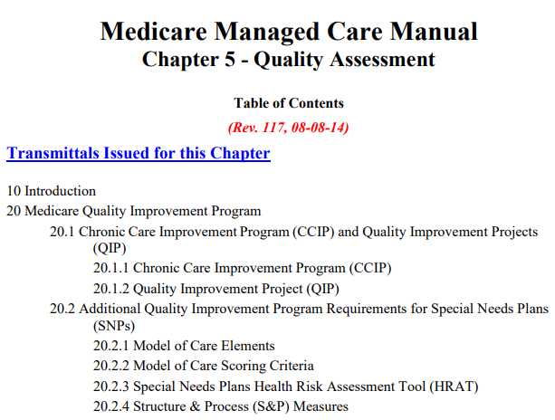
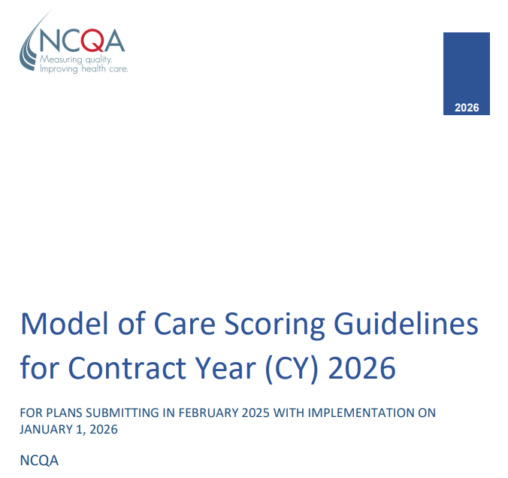
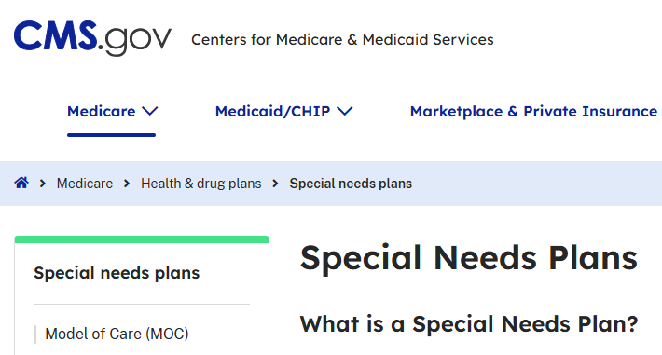
Training Resources
Medicare Managed Care Manual, Chapter 5- Quality Assessment 20.2.1 - Model of Care Elements
Model of Care Scoring Guidelines for Contract Year (CY) 2026
Special Needs Plans | CMS

Slide 27
Abbreviations
CC | Care Coordinator
CMS | Centers for Medicare & Medicaid Services
CPG | Clinical Practice Guidelines
C-SNP | Chronic Condition SNP
CTP | Care Transition Protocols
D-SNP | Dual Eligible SNP
ECM | Enhanced Care Management
HRAT | Health Risk Assessment Tool
ICP | Individualized Care Plan
ICT | Interdisciplinary Care Team
I-SNP | Institutional SNP
MOC | Model of Care
SNP | Special Needs Plan

